Slide 1

Sentiment Analysis by Scraping Data of User Reviews for Google App
Rahul Mahipati Bagal

Slide 2
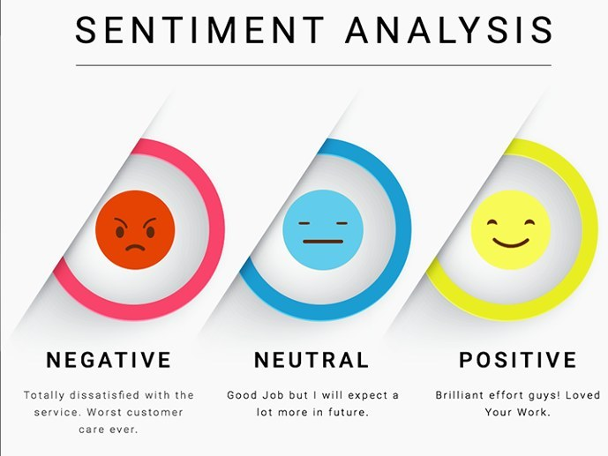
Objective
Business Inside:
Identify the key business insides and comparation of the user behaviour w.r.t their apps
Sentimental classification:
Develop an attribute Sentiment Analysis model by scraping user reviews for apps. Hence, help the companies to analyse their customer behaviours , app enhancements and competitor analysis.

Slide 3

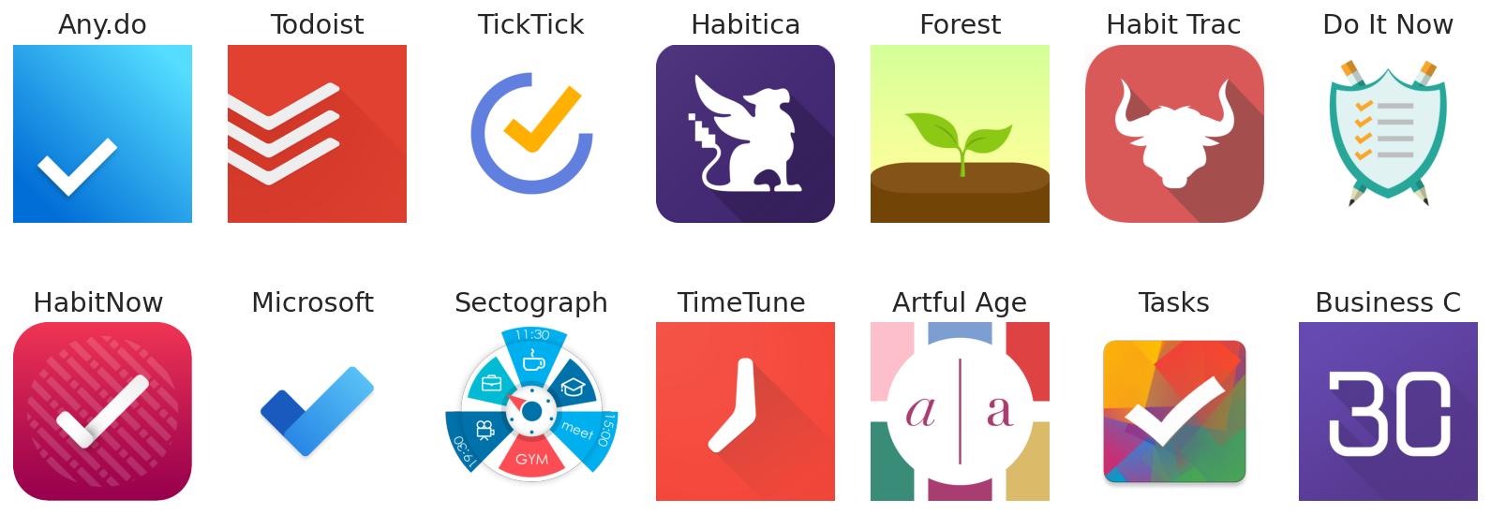
Scraping App Information
We scraped app info and reviews using the google-play-scraper package.
We can choose plenty of apps to analyze. But different app categories contain different audiences, domain-specific quirks, and more. We'll start simple.
Apps are constantly being updated, so the time of the review is an important factor.

Slide 4
App information Snippet
{
"appId": "com.anydo",
"at": "2020-04-05 22:25:57",
"content": "Update: After getting a response from the developer I would change my rating to 0 stars if possible.
These guys hide behind confusing and opaque terms and refuse to budge at all "repliedAt": "2020-04-07 14:09:03",
"replyContent": "Our policy and TOS are completely transparent and can be found in the Help Center and our main page
"reviewCreatedVersion": "4.17.0.3",
"score": 1,
"sortOrder": "most_relevant",
"thumbsUpCount": 37,
"userImage": "https://lh3.googleusercontent.com/a-/AOh14GiHdfNEu1DwwcJ6yNyju8Yvn4JwjpzuXvD74aVmDA",
"userName": "Andrew Thomas"
}

Slide 5

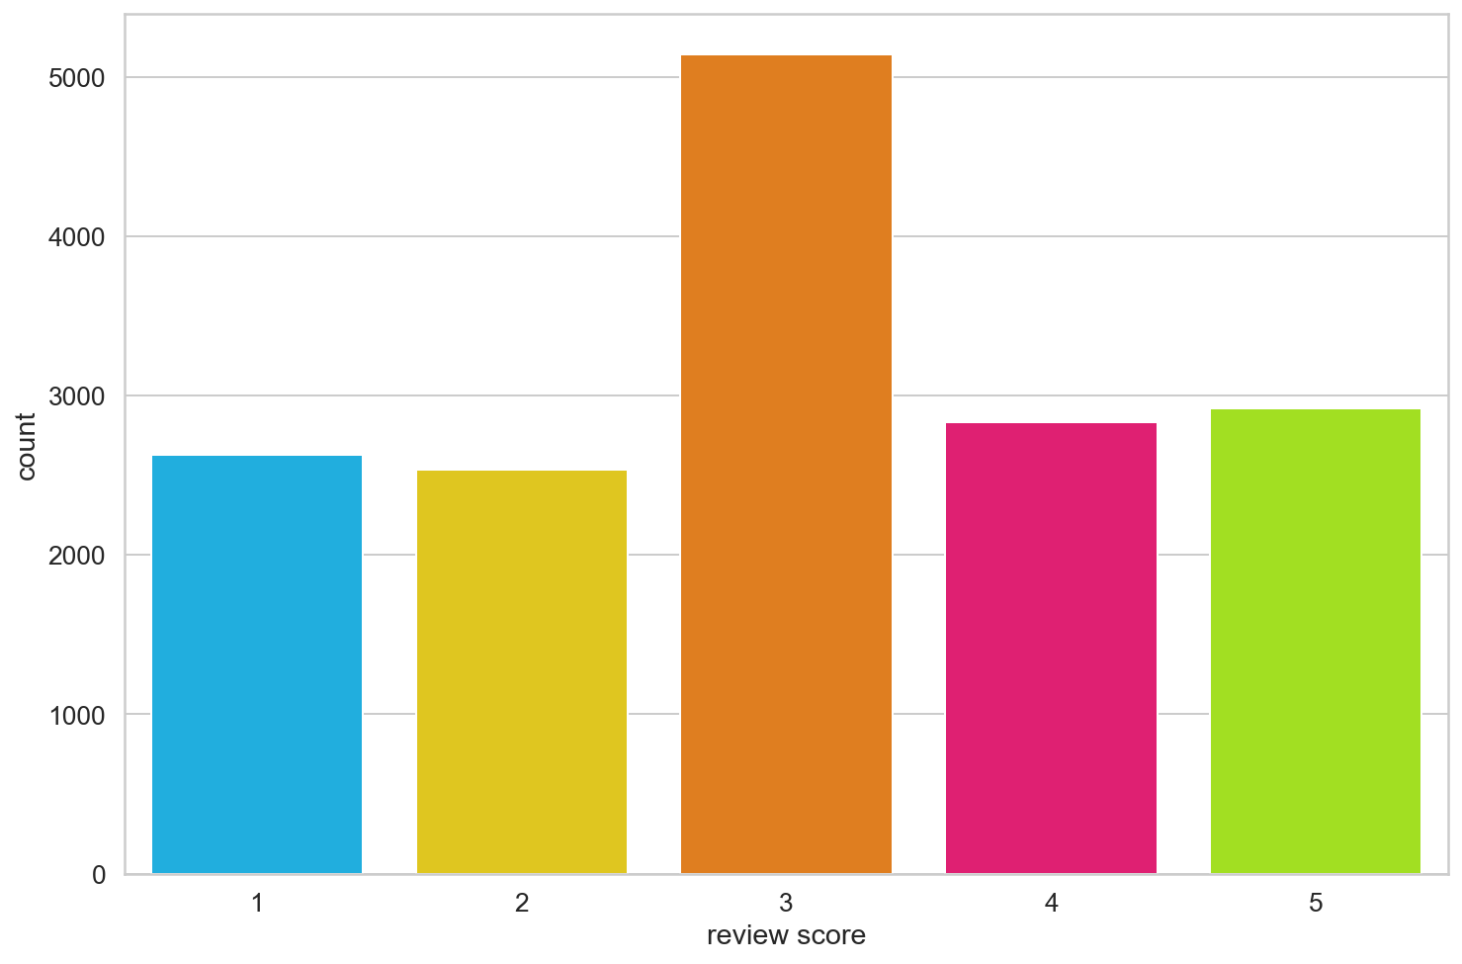
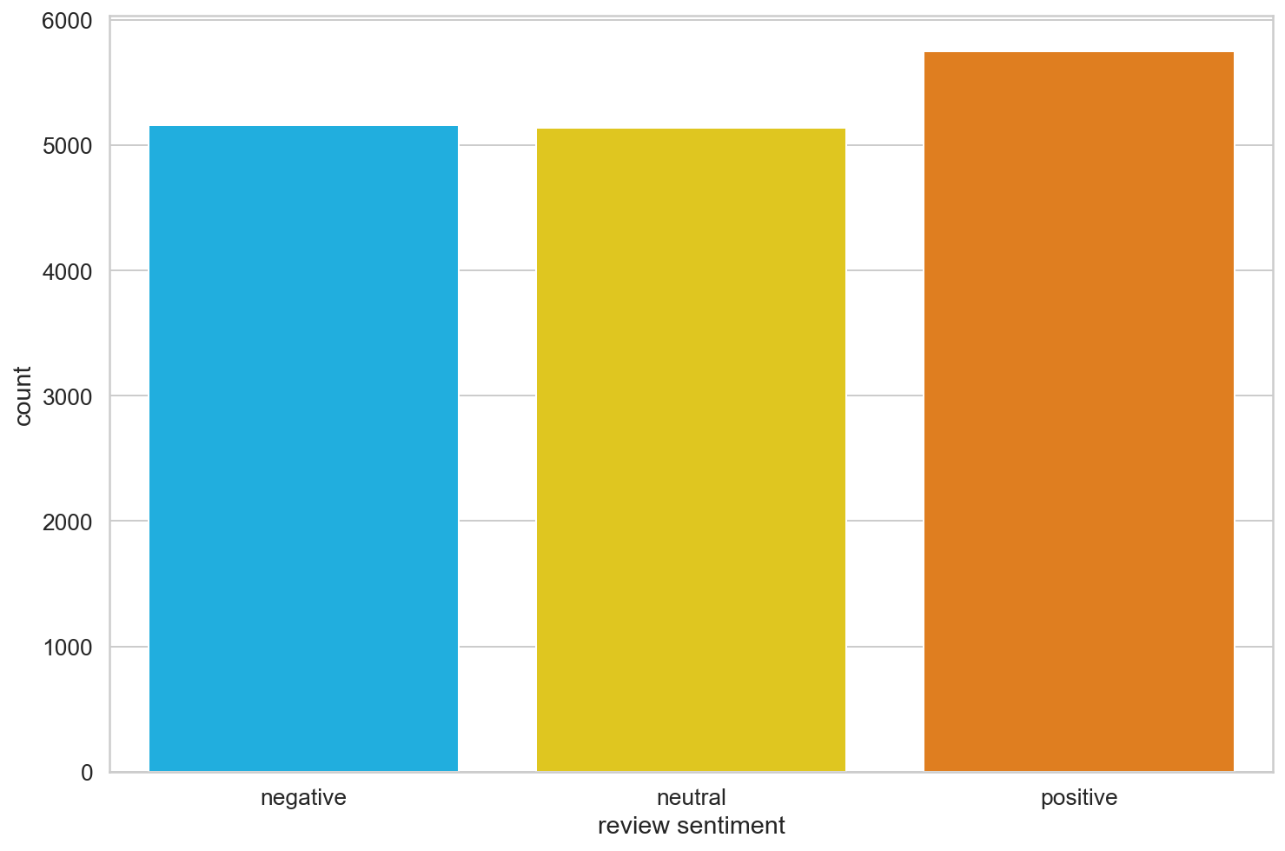
Initial observation
Total scrapped info : 16,054

Slide 6
Text Observations and insides
appId | Review_counts
cc.forestapp | 1200
com.anydo | 1200
com.appgenix.bizcal | 1200
com.appxy.planner | 1200
com.artfulagenda.app | 246
com.gmail.jmartindev.timetune | 1200
com.habitnow | 610
com.habitrpg.android.habitica | 1200
com.levor.liferpgtasks | 798
com.microsoft.todos | 1200
com.oristats.habitbull | 1200
com.tasks.android | 1200
com.ticktick.task | 1200
com.todoist | 1200
prox.lab.calclock | 1200
Data collected between the time period’s
2014-09-28 and 2020-07-19

Slide 7
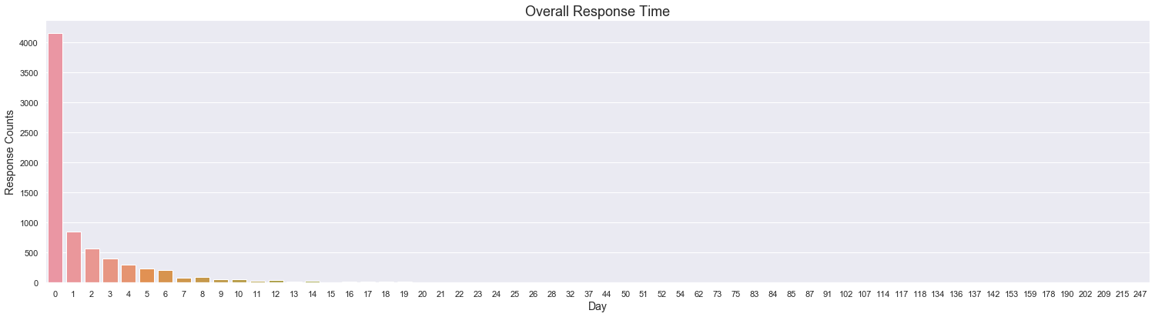
Overall App Service-to-Users Response Duration Analysis

Slide 8
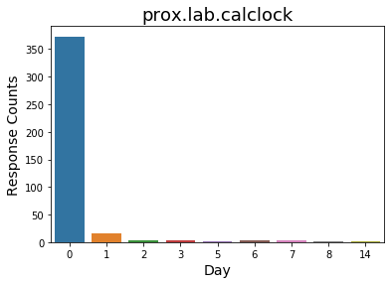
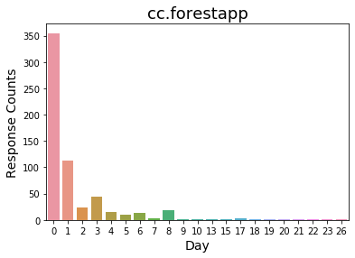
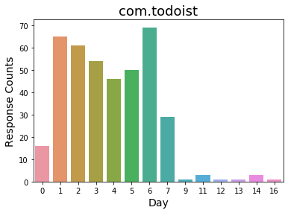
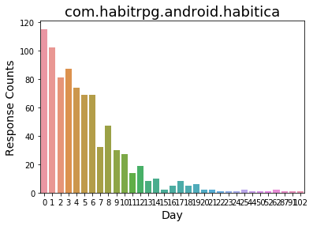
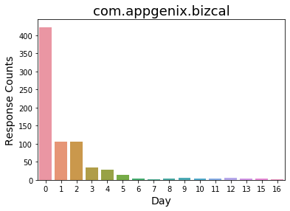
Deep drive – App Service-to-users Response Duration Analysis

Slide 9
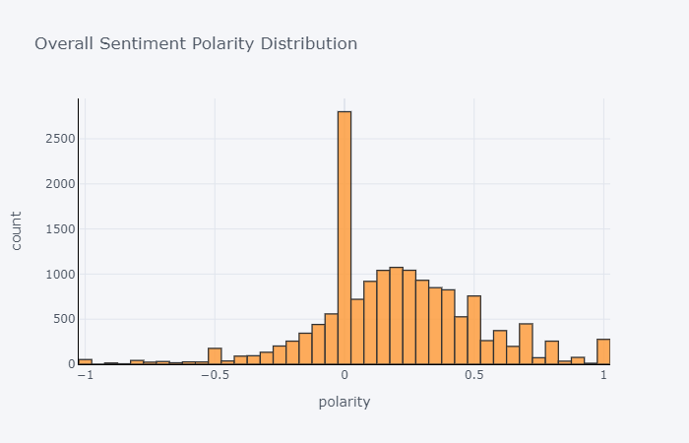
Overall Sentiment Polarity Distribution

Slide 10
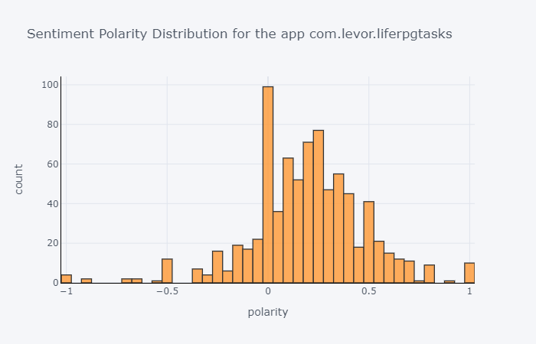
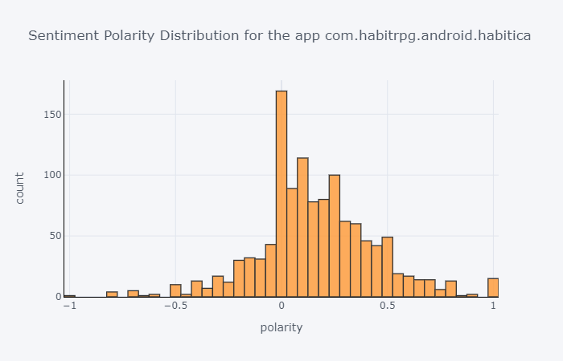
Deep Drive Apps -Sentiment Polarity Distribution

Slide 11
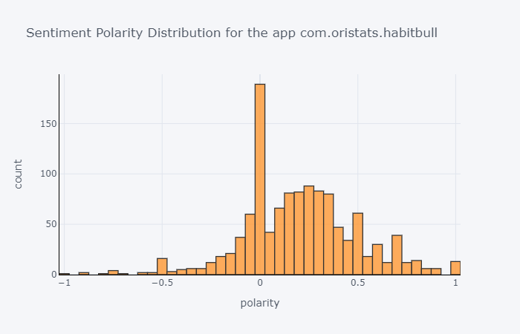
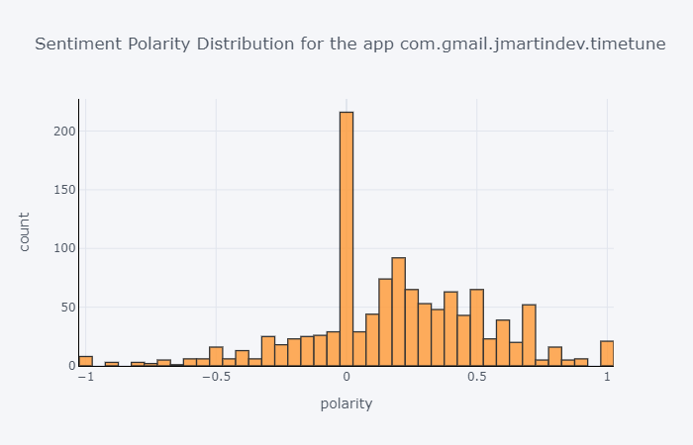
Deep Drive Apps -Sentiment Polarity Distribution

Slide 12
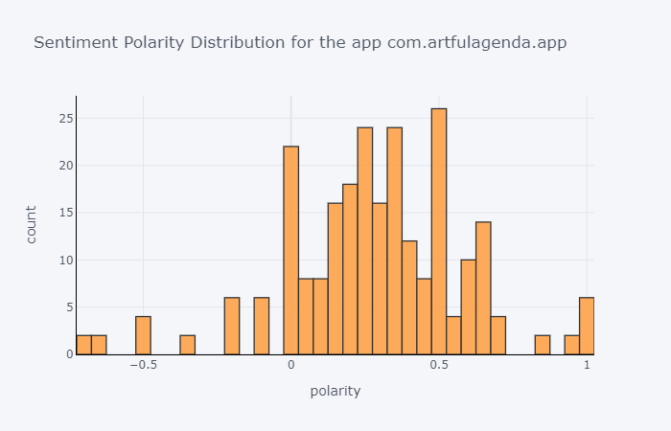
Deep Drive Apps -Sentiment Polarity Distribution

Slide 13
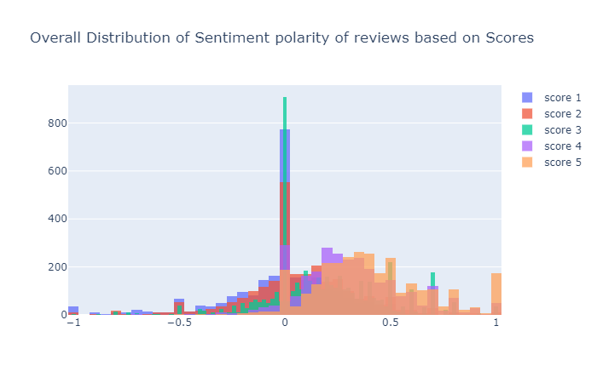
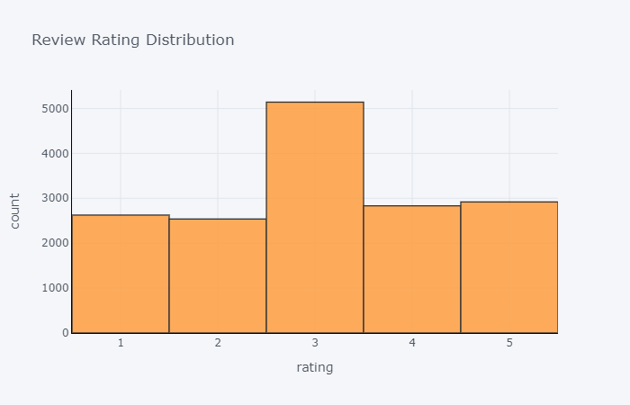
Sentiment Polarity Distribution w.r.t the Users Scores

Slide 14
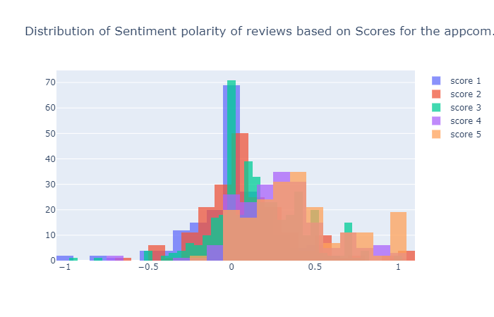
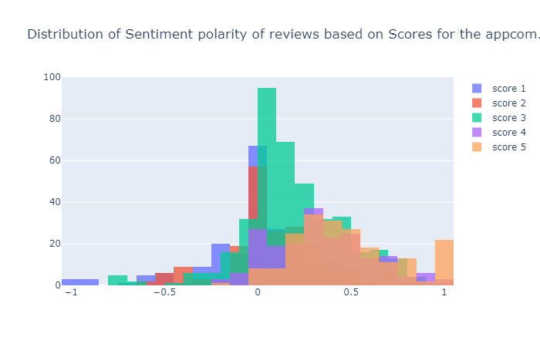
Deep drive - Sentiment Polarity Distribution w.r.t the Users Scores

Slide 15
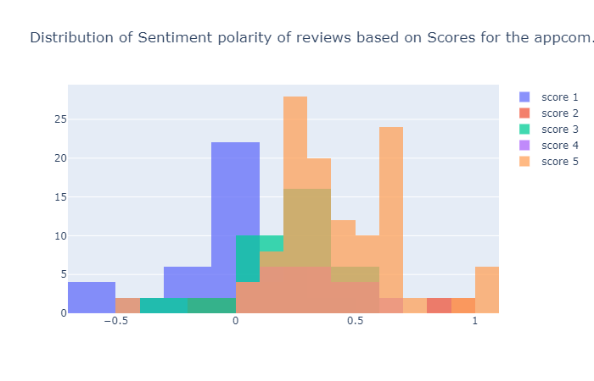
Deep drive - Sentiment Polarity Distribution w.r.t the Users Scores

Slide 16
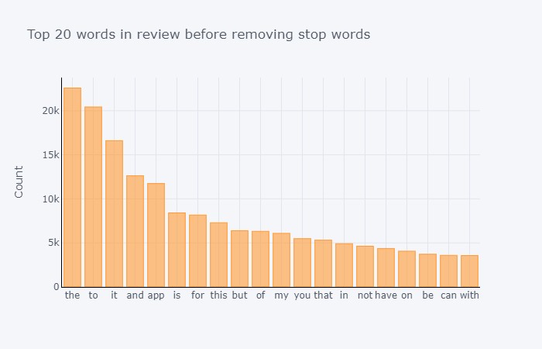
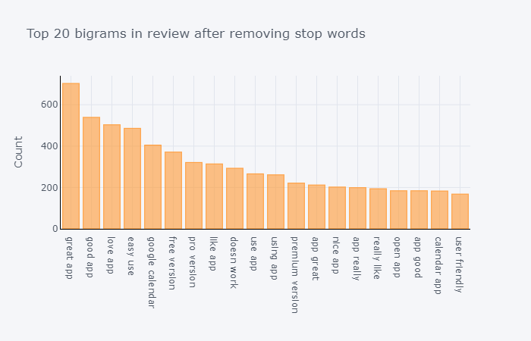
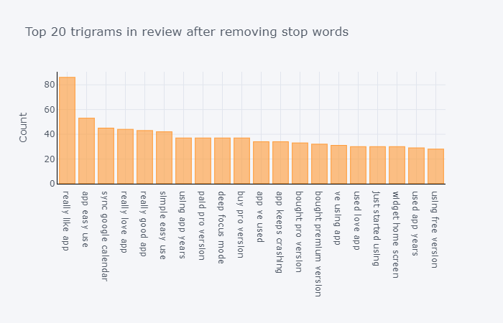
Senti-N-Gram - ngram sentiment analysis

Slide 17
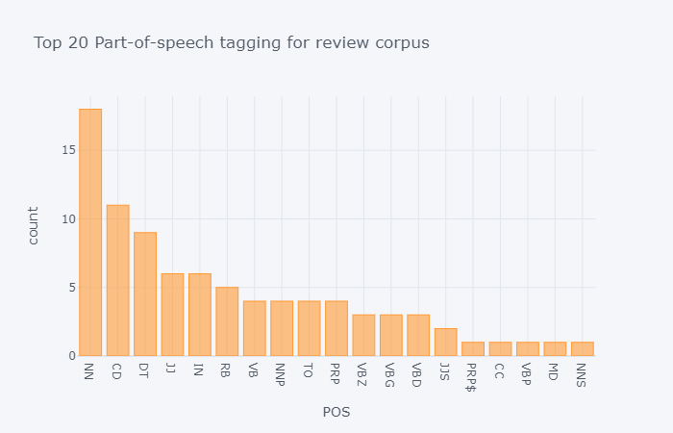
Part of Speech Tagging (POS)

Slide 18
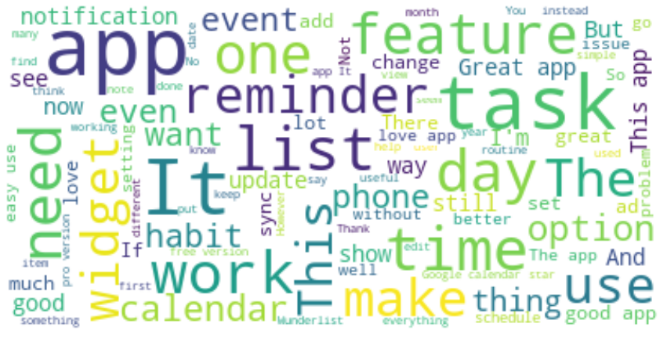
Word Cloud

Slide 19
Text classifications : Flow of the Process
Scarping information the relevant apps
Text Preprocessing
Model Building
Text Transformation
Evaluate Model
Re-iterate, if Goal is not met

Slide 20
Preprocessing Steps:
Lowercase
remove_punctuation
remove_whitespace
stop_words
WordNetLemmatizer
"[SEP] [CLS]"
'Unable to register with an email. Clicking"continue with email" will just take you to a login page. Complete waste of time. I searched them first three pages of Google for a solution and found nothing. Found no solution on their help section. I don\'t want to register with Facebook or Google. If you include a feature, make sure it actually works.’
'unable register email click continue email take login page complete waste time search first three page google solution find nothing find solution help section want register facebook google include feature make sure actually work [SEP] [CLS]'

Slide 21
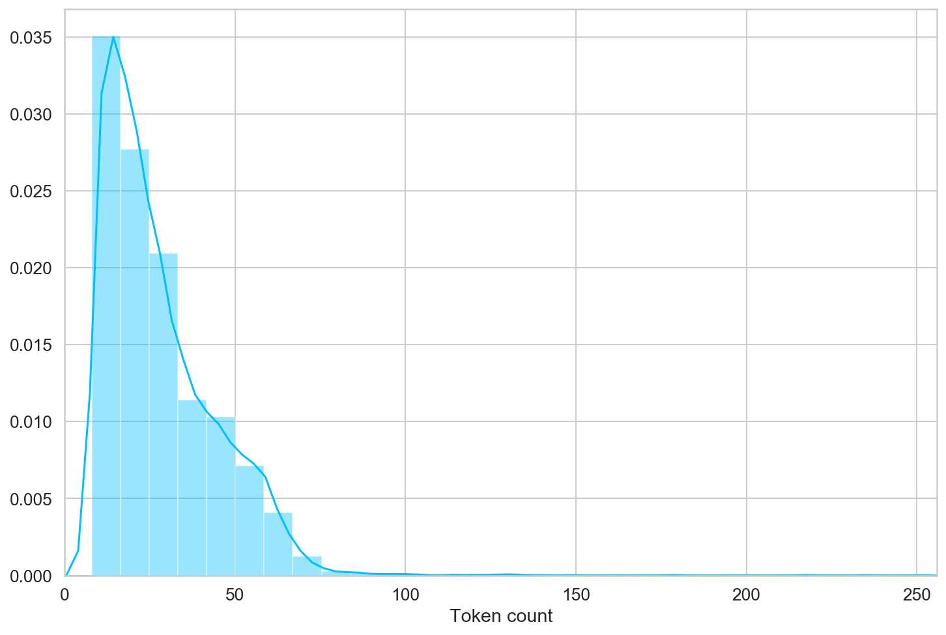
Fixing the length size of the sentences
Most of the reviews seem to contain less than 80 tokens, but we'll be on the safe side and choose a maximum length of 100.
In the next step we will use XLNet architecture for building text classification model.

Slide 22
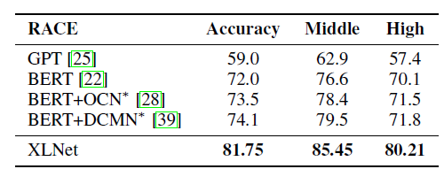
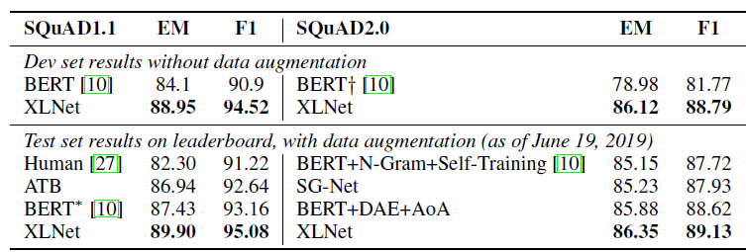
Why using XLNet model
We will use XLNet pretrained deep learning architecture model for classification
XLNet outperforms (in terms of accuracy) most of the advanced models like BERT in many use cases.
Example:
SQuAD and NewsQA are also popular reading comprehension datasets which consist of two tasks. Specifically, XLNet jointly trains on SQuAD 2.0 and NewsQA and obtains state-of-the-art performance on this task, outperforming BERT even on the dev set (see results below).
* https://www.kdnuggets.com/2019/07/xlnet-outperforms-bert-several-nlp-tasks.html

Slide 23
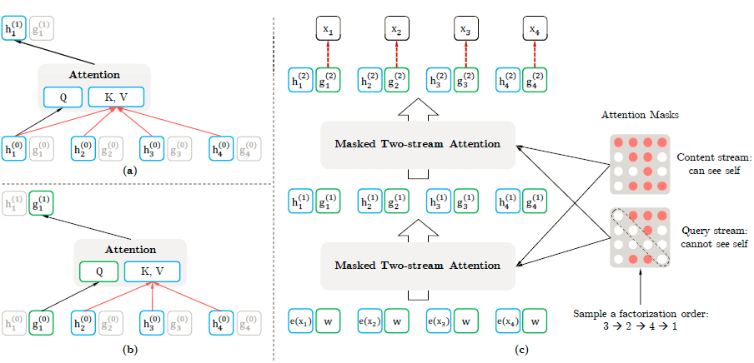
XLNet Architecture

Slide 24
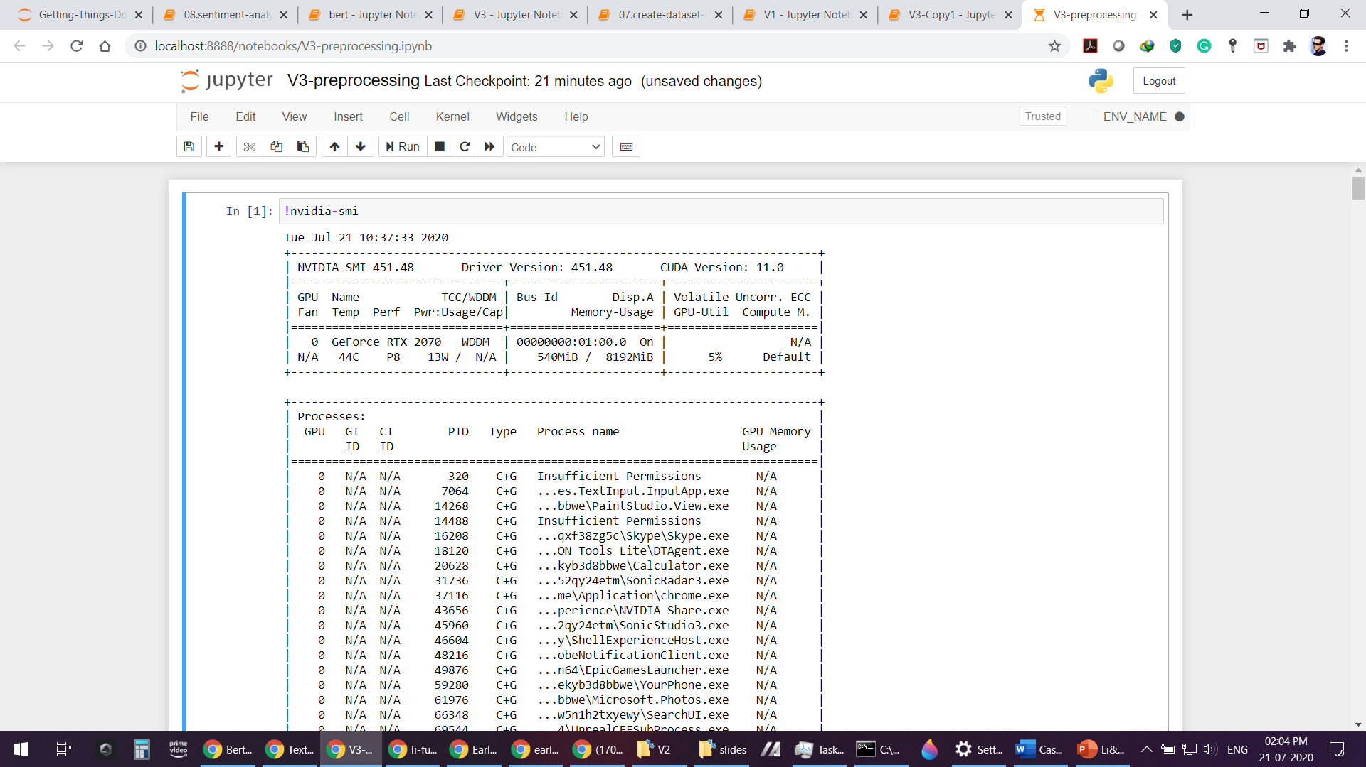
GPU and Pytorch Framework to build the Model

Slide 25
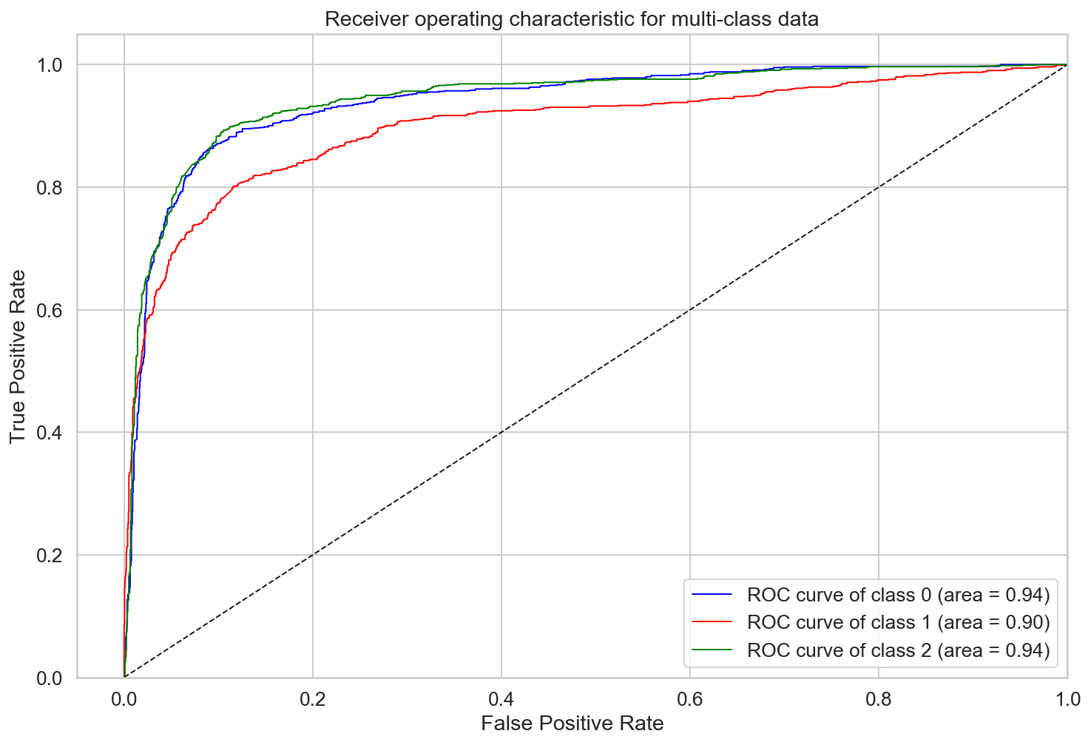
Model Validation and Metrics
Below are the matrices for the test data set that helps us to understand the model performances
 | precision | recall | f1-score | support
Negative | 0.82 | 0.85 | 0.84 | 1003
Neutral | 0.78 | 0.78 | 0.78 | 1034
Positive | 0.87 | 0.84 | 0.85 | 1174
accuracy |  |  | 0.83 | 3211
macro avg | 0.82 | 0.82 | 0.82 | 3211
weighted avg | 0.83 | 0.83 | 0.83 | 3211
cohen_kappa_score
0.737

Slide 26

What next…
Scraped large data with more time periods
Building the deep learning models from scratch with customized embedding word2vec that gives more control as well as can be compared with the predefined transfer models performance’s
Trying different architectures with difference word2vec techniques.
Create customer generators functions to get more control of passing the data to the model at each iterations if we are dealing with high imbalance classification data

Slide 27


